Slide 1
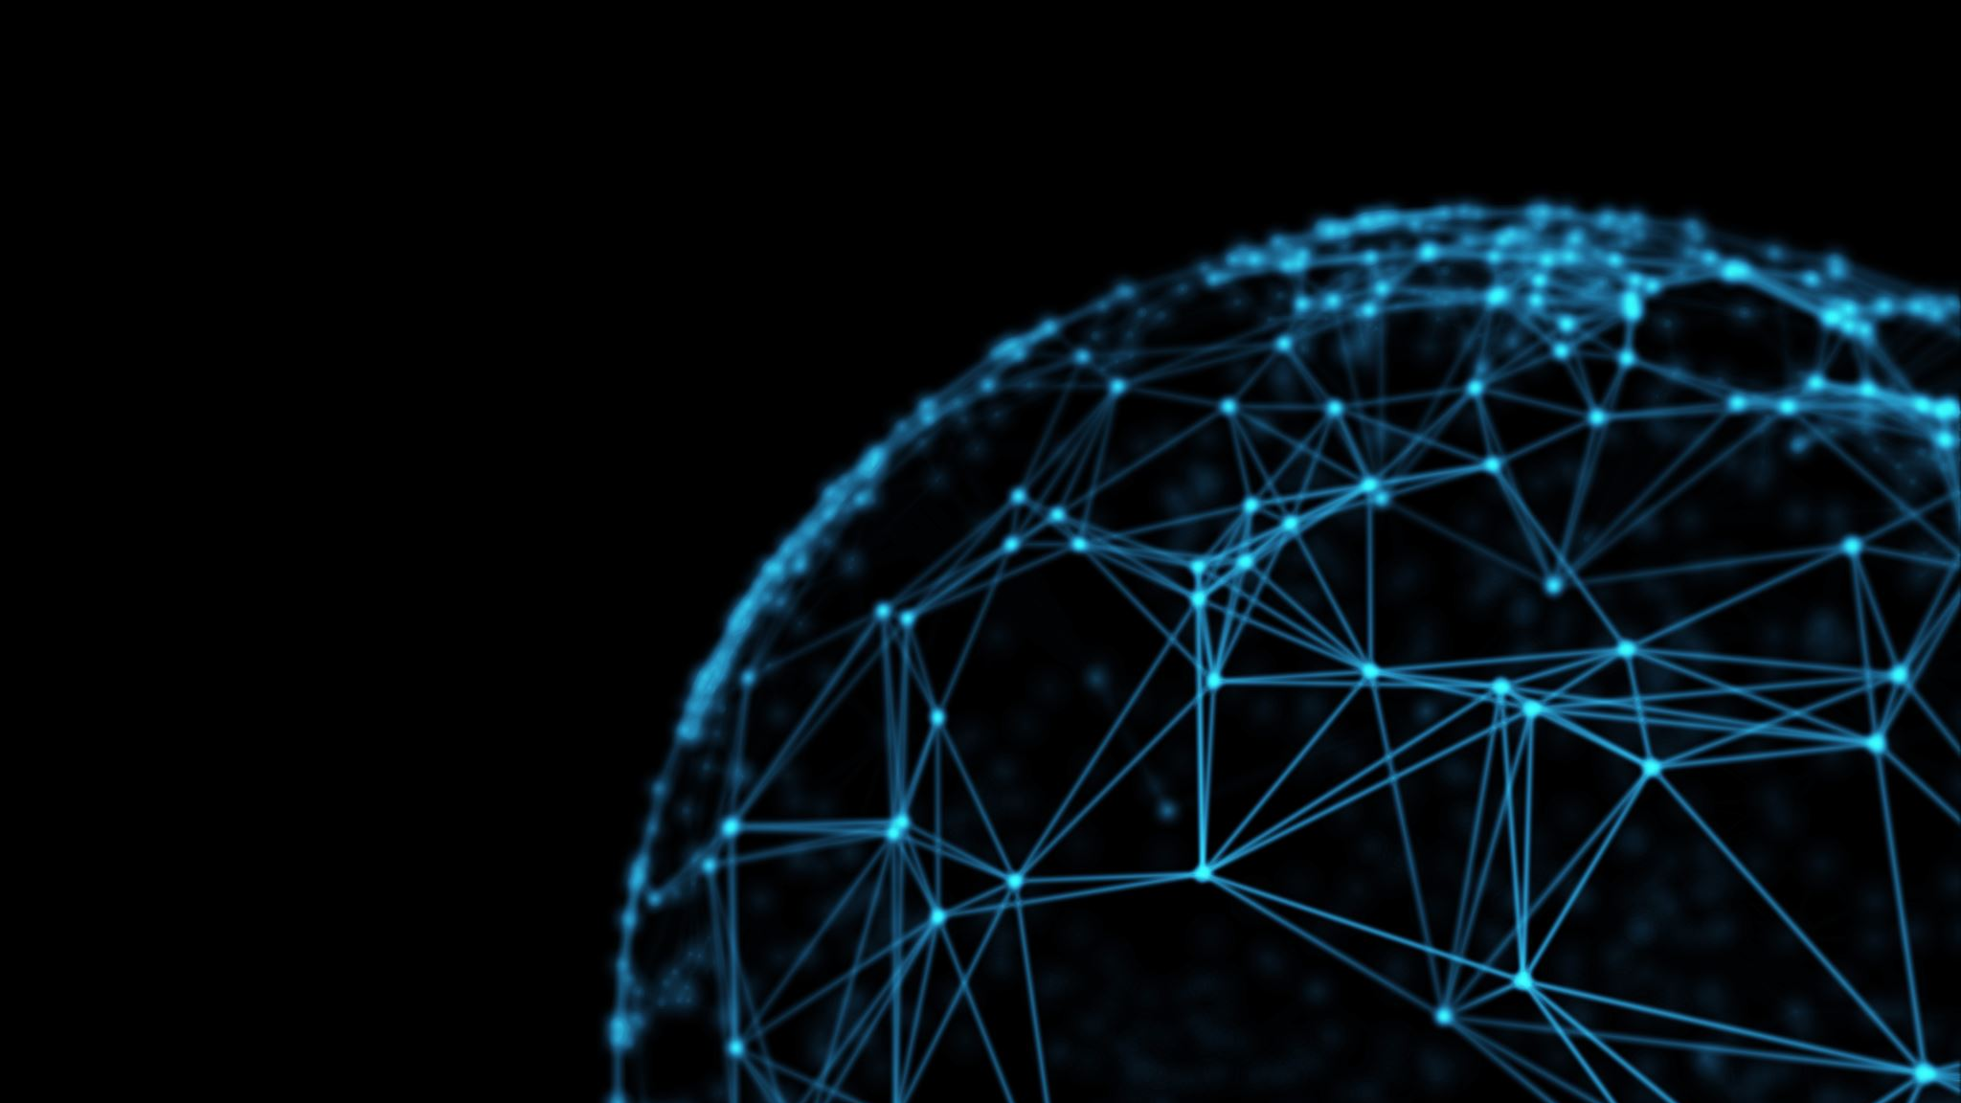
Embeddings
Ahtisham Fazeel

Slide 2
OUTLINE
Graphs
Embeddings
Word2Vec Revision
Detailed GNN Model
Overview of GCN
Detailed GraphSAGE

Slide 3
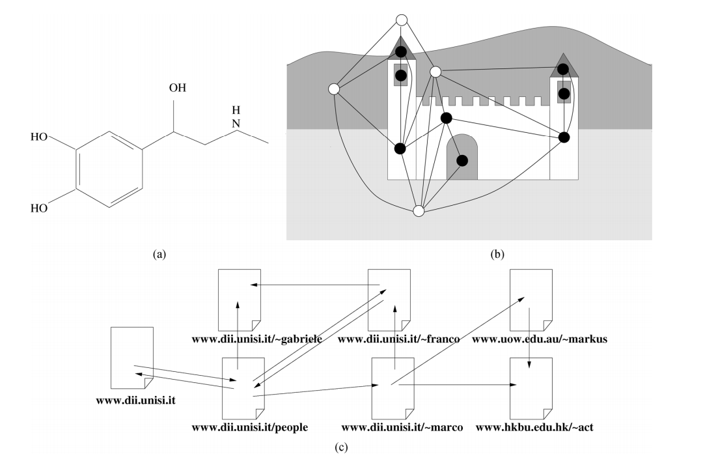
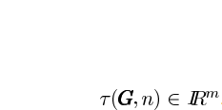
Application to graphical domains: Graph Focused and Node focused
that maps a graph G and one of its nodes n to a vector of reals

Slide 4
How to represent graph based data ?
Random vector representation
Traditional ML techniques
Embeddings

Slide 5
Why to embed?
Machine learning algorithms don’t understand complex data structures:
Text
Graphs etc.
We can One hot encode them ! But why not ?
Conversion of data into some numbers and preserving contextual relationship.

Slide 6
Embeddings
Predicting potential drug indications based on drug-disease association (DDA) graphs
Detecting long non-coding RNA (lncRNA) functions based on lncRNA–protein interaction networks
Assisting clinical decision making via disease-symptom graphs

Slide 7
Types of embeddings
Spectral embeddings
Laplacian matrix (A-D), matrix factorization and SVD
Diffusion based embeddings
Deepwalk coupled with w2vec
Node2vec coupled with w2vec
Graph Neural Networks based embeddings
RecGNN etc.

Slide 8
Random Vectors
Graph Neural Networks (RecGNN)
Diffusion Based Models
Graph Convolution Network
Spatial
Spectral
Spectral Model
Matrix factorization
SVD
DeepWalk
Node2vec
N
Chebyshev
GRAPHSAGE
GAN
Traditional Machine Learning

Slide 9
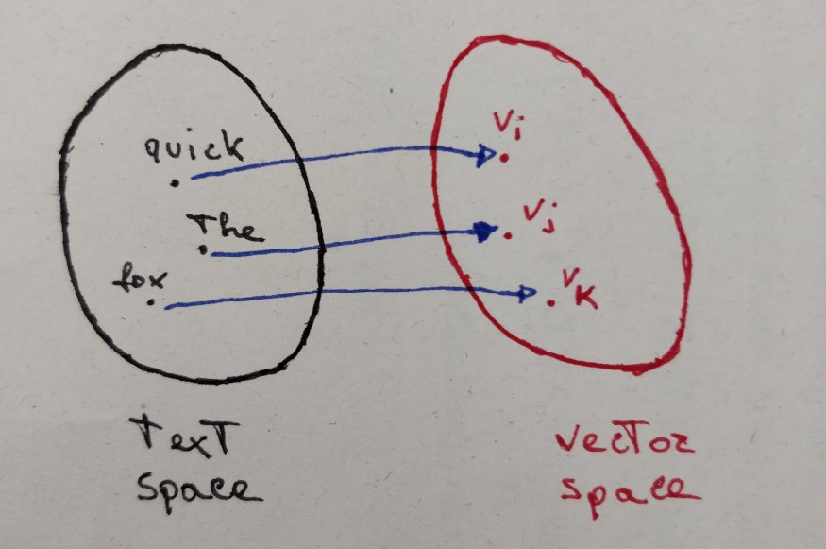
Word2vec Revision

Slide 10
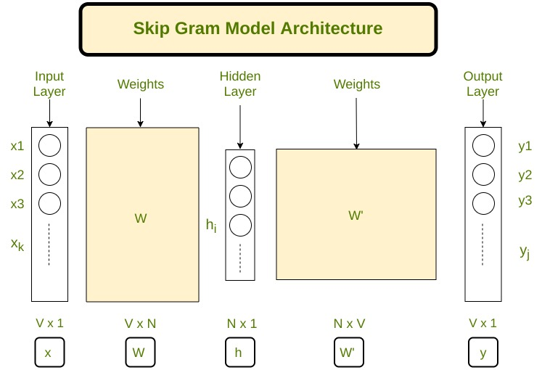
Word2Vec revision

Slide 11
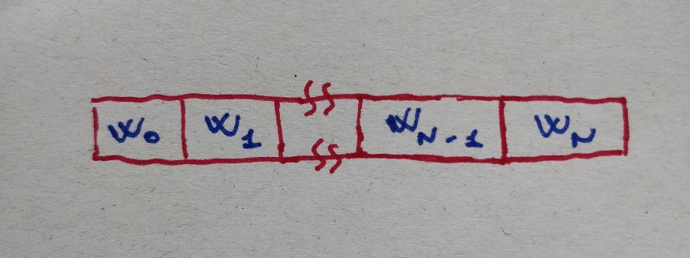
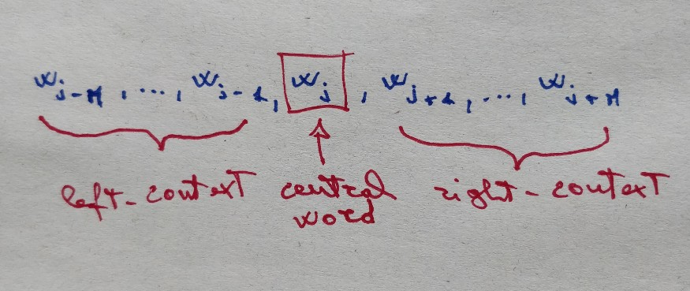
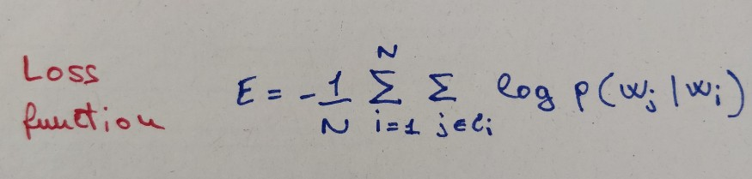
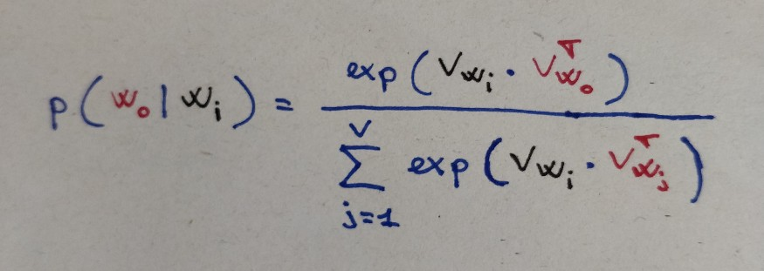
Text as a word sequence of words
Then for word wⱼ, context of wⱼ is given by its left and right neighborhood:
Loss
Output probability is given by softmax of vector product

Slide 12


The graph neural network model
First convincing model proposed related to graphs.
Recurrent Graph Neural Network
Based on Banach Fixed Point Theorem:
Let (X,d) be a complete metric space and let (T: X->X) be a contraction mapping.
T has unique fixed point (x*) for any (X∈X) the sequence T_n(x) for n ➔∞ converges to (x*). This means the application of T on x for k times, x^k should be equal to x^k-1

Slide 13
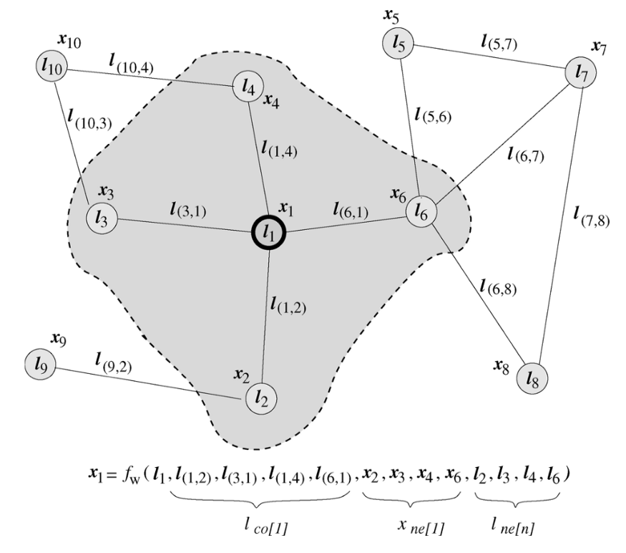
GNN Model
l_n, represents the features of the current node [n],
l_co, the edges of the node [n],
x_ne, the state of the neighboring nodes,
l_ne the features of the neighboring nodes

Slide 14

GNN Model
Finally, after k iterations, the final node state is used to produce an output to make a decision about each node. The output function is defined as:

Slide 15
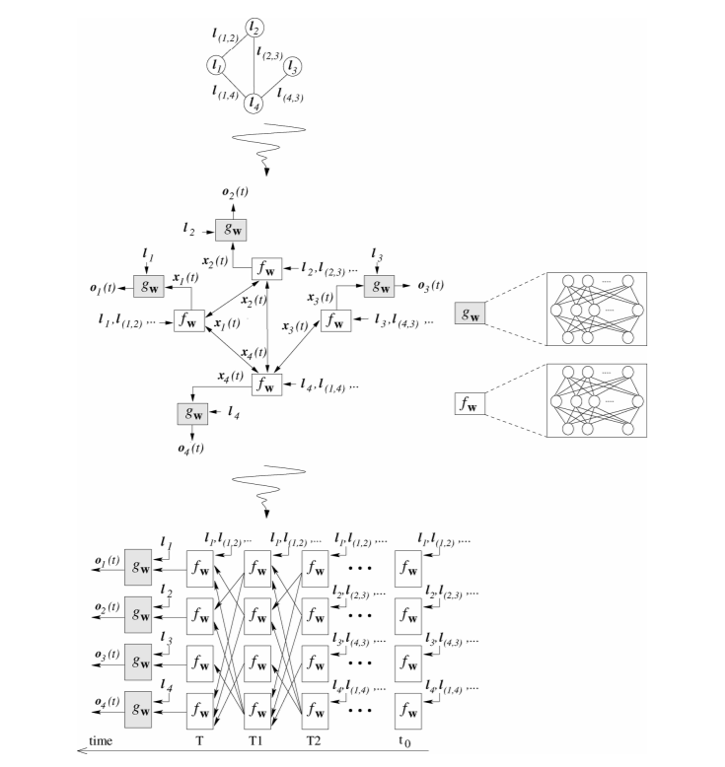
UNFOLDING THE PICTURE

Slide 16
Problems with this network
If the assumption of “fixed point” is relaxed, it is possible to leverage Multi-layer Perceptron to learn a more stable representation, and removing the iterative update process. This is because, in the original proposal, different iterations use the same parameters of the transition function f, while the different parameters in different layers of MLP allow for hierarchical feature extraction.
It cannot process edge information (e.g. different edges in a knowledge graph may indicate different relationship between nodes)
Fixed point can discourage the diversification of node distribution, and thus may not be suitable for learning to represent nodes

Slide 17
GRAPh Convolutional Neural network

Slide 18
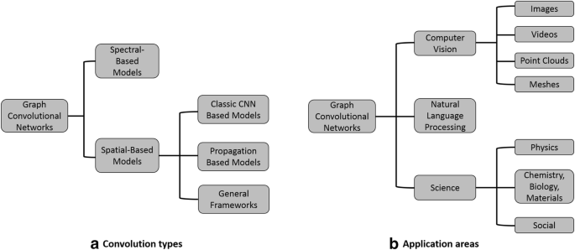

Slide 19
Types of Graph CNNs
They also have two main types:
- Spectral
- Based on signal propagation
- Expensive operation
- Spatial
Graph Convolutional Neural Networks (GraphCNN).
Graph Attention Convolutional Neural Networks (GraphAttentionCNN).
Graph Convolutional Recurrent Neural Networks (GraphConvLSTM).
Graph Capsule Convolutional Recurrent Neural Networks (GraphCapsuleCNN) TBD.
Graph Message Passing Neural Networks (GraphNeuralNetworks) TBD.
Keras-DGL also contains implementation of various graph convolutional filters TBD.

Slide 20

SPECTRAL GCN (A small overview)
Transform the graph into the spectral domain using eigendecomposition
Apply eigendecomposition to the specified kernel
Multiply the spectral graph and spectral kernel
Return results in the original spatial domain
AX

Slide 21
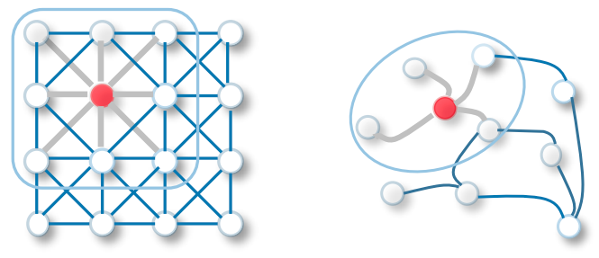
Simple Convolution Network vs Graph Convolution Network

Slide 22
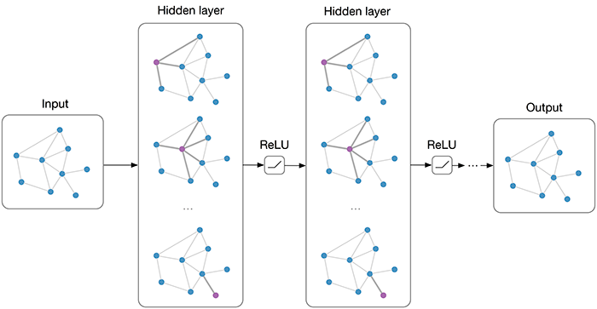
Multi-layer Graph Convolutional Network (GCN) with first-order filters.

Slide 23
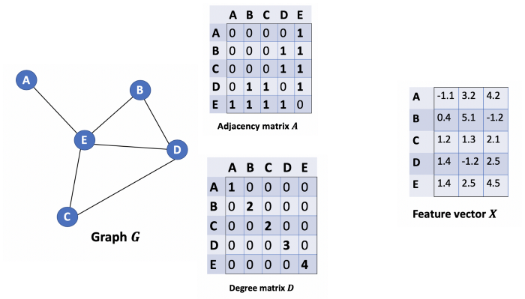

GCN

Slide 24
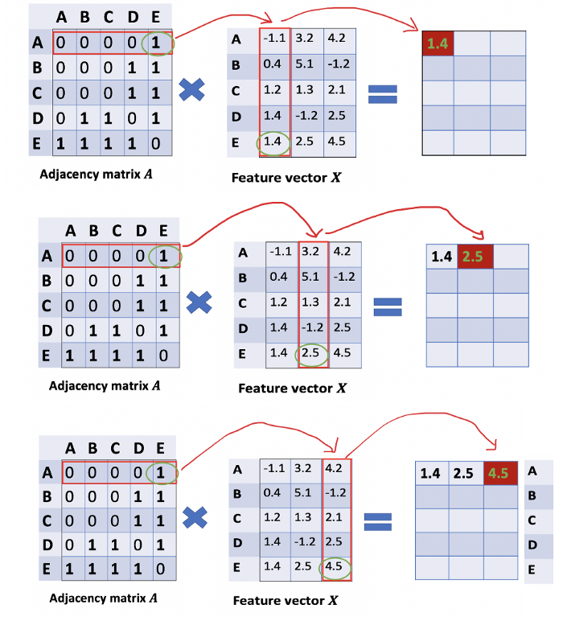
GCN

Slide 25
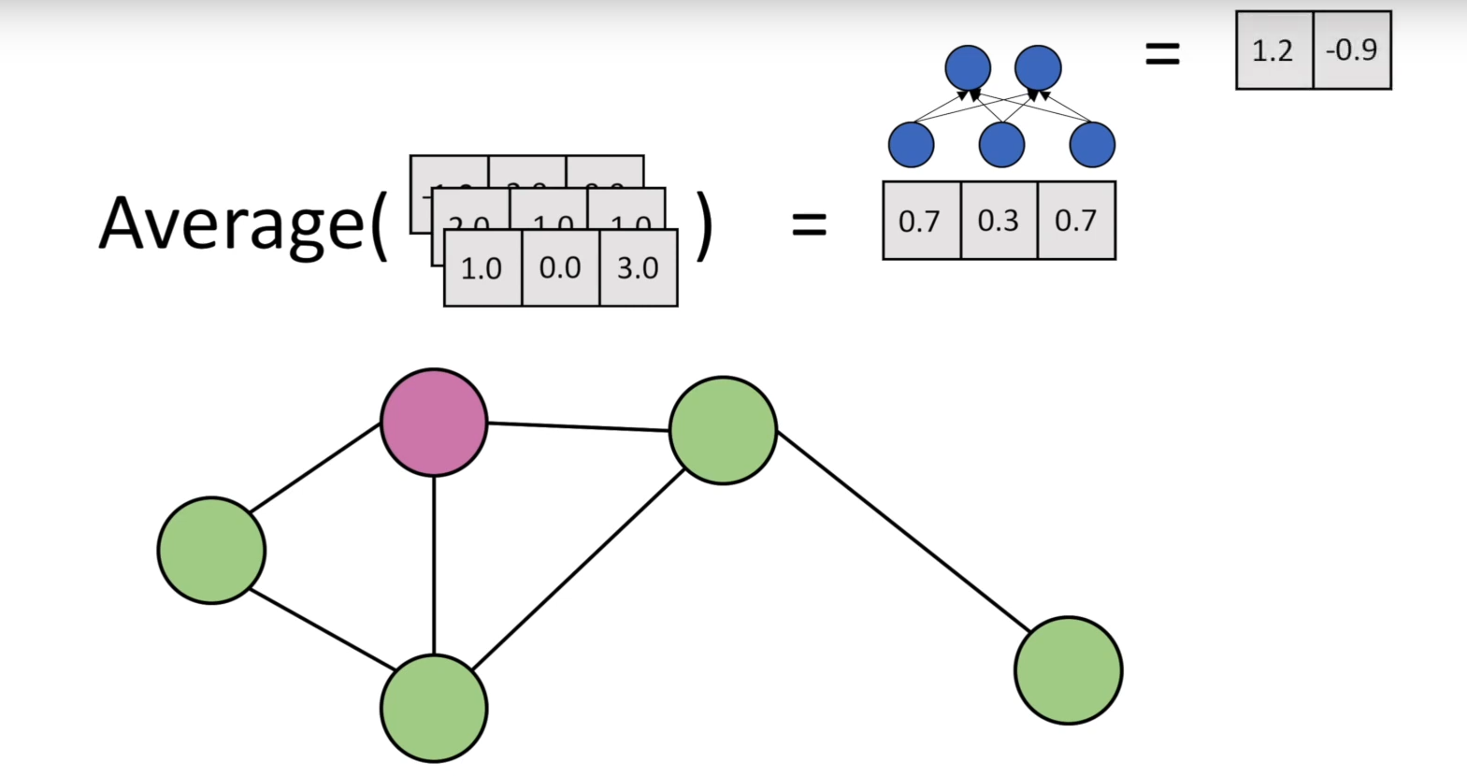

Slide 26
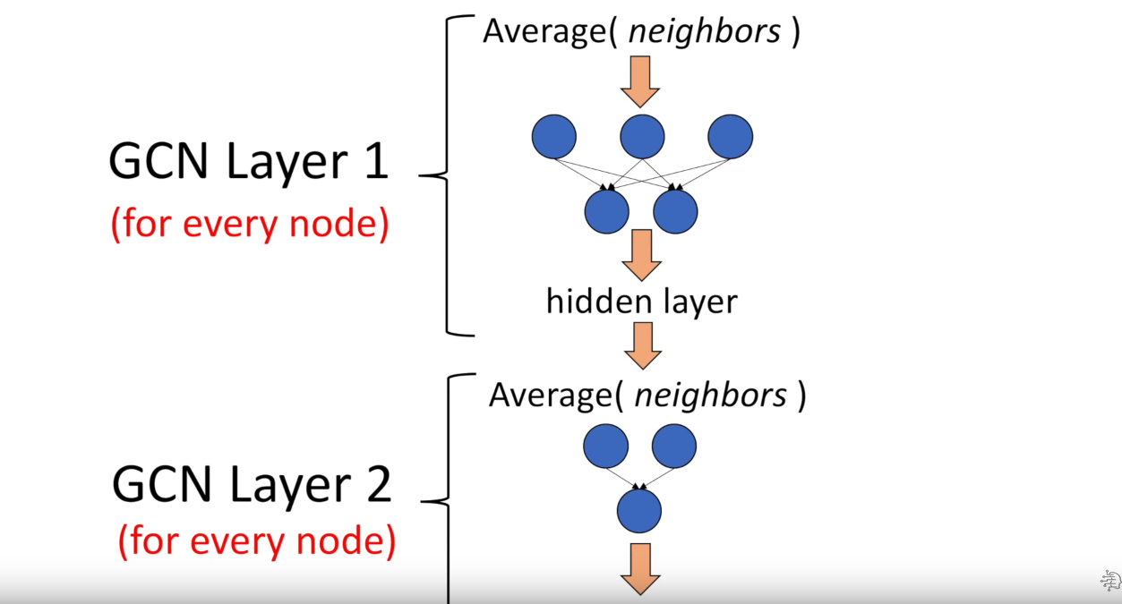

Slide 27
Spectral Convolution In a spectral graph convolution, we perform an Eigen decomposition of the Laplacian Matrix of the graph. This Eigen decomposition helps us in understanding the underlying structure of the graph with which we can identify clusters/sub-groups of this graph. This is done in the Fourier space. An analogy is PCA where we understand the spread of the data by performing an Eigen Decomposition of the feature matrix. The only difference between these two methods is with respect to the Eigen values. Smaller Eigen values explain the structure of the data better in Spectral Convolution whereas it's the opposite in PCA. ChebNet, GCN are some commonly used Deep learning architectures that use Spectral Convolution
Spatial Convolution Spatial Convolution works on local neighbourhood of nodes and understands the properties of a node based on its k local neighbours. Unlike Spectral Convolution which takes a lot of time to compute, Spatial Convolutions are simple and have produced state of the art results on graph classification tasks. GraphSage is a good example for Spatial Convolutio

Slide 28
Why Graphsage ?
Spectral Embeddings are transductive
Addition of a node causes to repeat the whole training process
GRAPHSAGE is inductive

Slide 29
GraphSAGE
Sample and aggregate

Slide 30
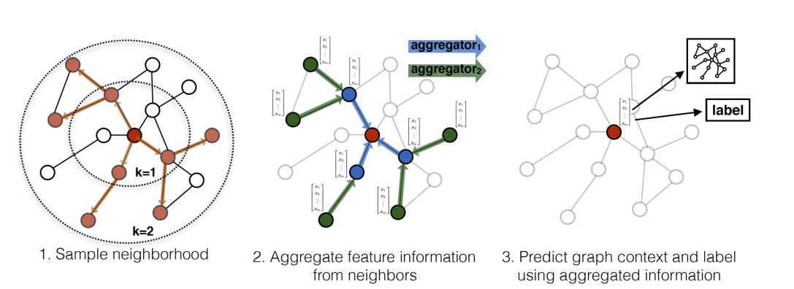

Slide 31
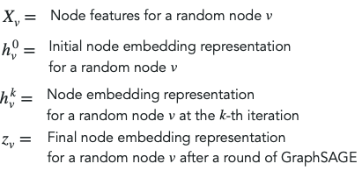
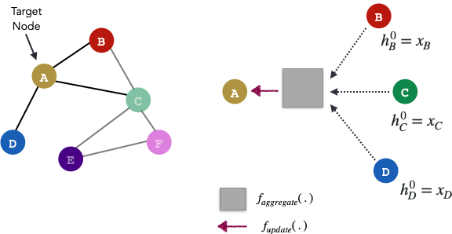
Terminology

Slide 32
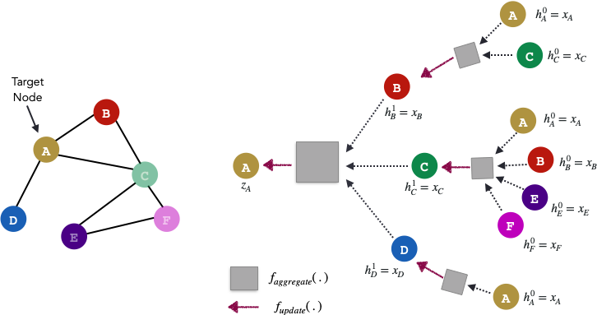
K=2 Lets take 2 steps

Slide 33
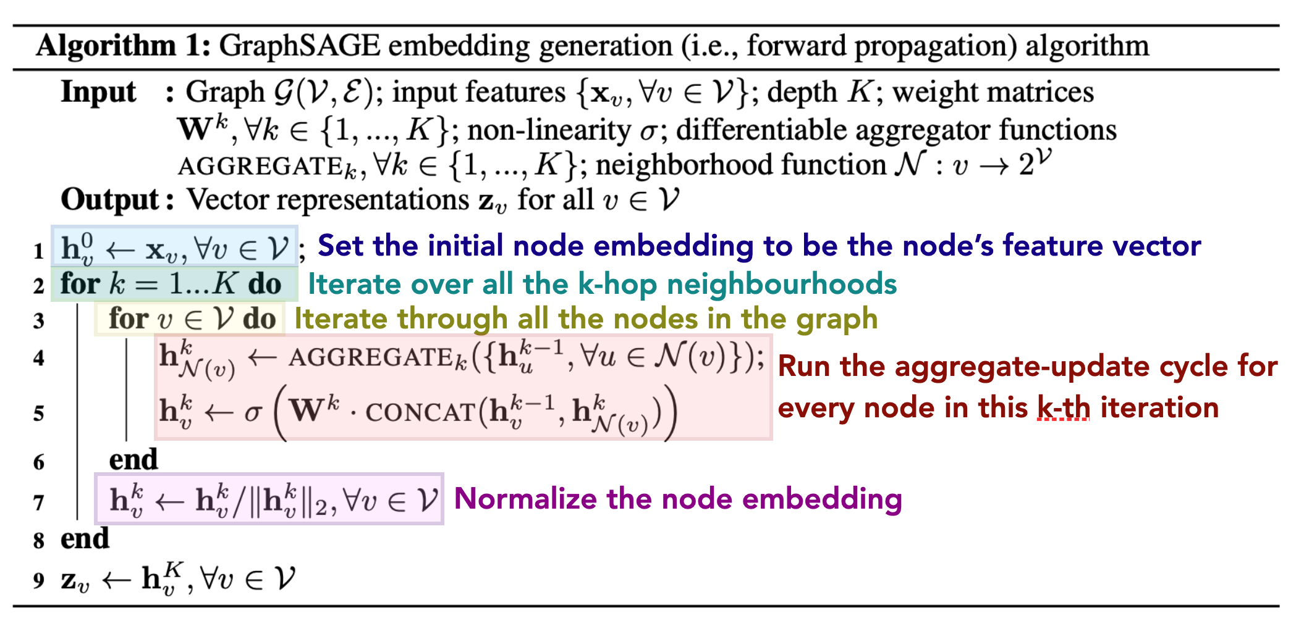

Slide 34
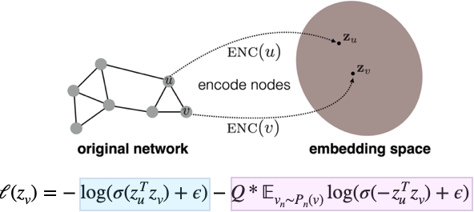
Loss function
The blue portion of the loss function tries to enforce that if nodes u and v are close in the actual graph, then their node embeddings should be semantically similar. In the perfect scenario, we expect the inner product of z_u and z_v to be a large number. The sigmoid of this large number gets pushed towards 1 and the log(1) = 0.
The pink portion of the loss function tries to enforce the opposite! That is, if nodes u and v are actually far away in the actual graph, we expect their node embeddings to be different/opposite.

